Slide 1

Optimal Location for Auto Mechanic in Maryland, USA

Slide 2



Business Needs
Find most favorable location for a car mechanic shop in Maryland, USA.
With compatible with shareholders' needs.
Not close range to any of competition.
Where in the State of Maryland, should the investors open an Auto Mechanic Shop?

Slide 3

Data
What’s required?
Passenger vehicle numbers in each city/county
Geolocation coordinates of each city/county
Number of existing mechanic shops in each city/county
What’s we have gathered
Using Foursquare API and State open data
1029 rows and 6 features in our data
Cleaned and wrangled the data

Slide 4
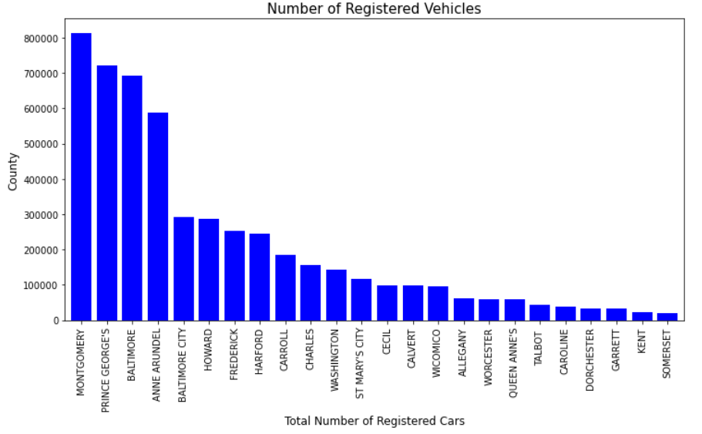
Having an Idea of Potential Counties

Slide 5
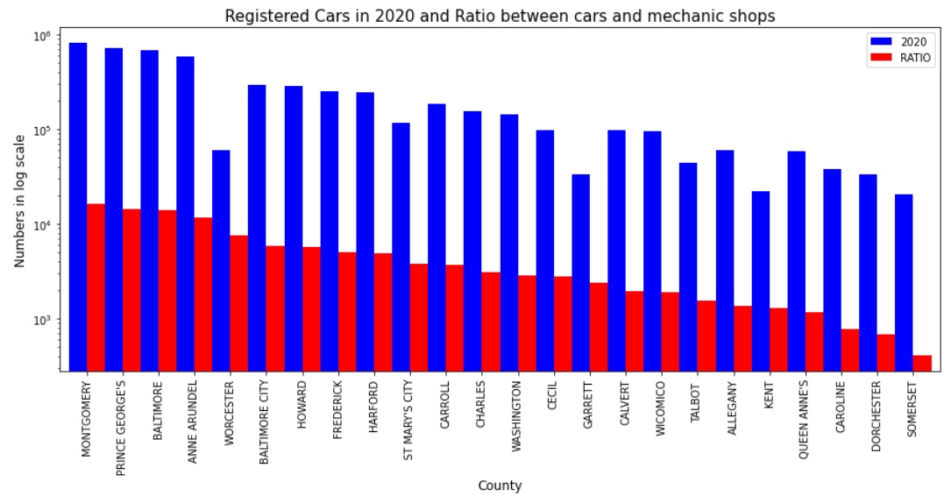
Finding 5 Potential Counties

Slide 6
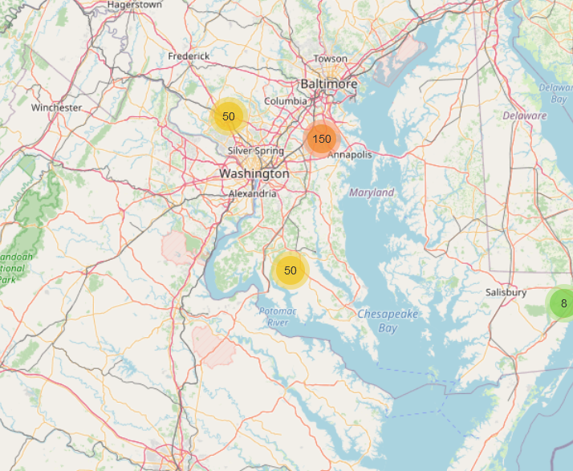
Baltimore has great number of Auto Mechanics
Worcester, Montgomery, Wicomico, and Anne Arundel promising

Slide 7
Highest concentration of mechanic shops was detected around city centers.
Mechanic shops density getting higher around Baltimore.
Worcester, Montgomery, Wicomico, and Anne Arundel counties are promising
Clustered to create zones of interest which contain greatest number of location candidates
Discussion

Slide 8
Identify Maryland Counties to aid stakeholders in narrowing down the search for optimal location.
Clustered those location to be used as starting points for final exploration by stakeholders.
Decision on optimal mechanic shops location will be made by stakeholders
Conclusion

